Slide 1
Intro to Docker

Slide 2
Intro to Docker Containers
As made popular by Docker

Slide 3
A container...
Is not a Virtual Machine
Does not have a complete Operating System
Notes:
Virtual Machines allow regular Operating Systems to run on emulated hardware. The Operating System is (mostly) oblivious to it.

Slide 4
A container...
Is a Virtual Environment
Is running on the host OS
Notes:
What’s a Virtual Environment?
An application and everything it needs to run.
Can resemble a regular computer, with its own copy of system utilites and software packages.
Can access only selected parts of the host file system and hardware.
A feature of the Operating System.

Slide 5
Containers are Great
For building applications
For shipping applications
For development environments

Slide 6
A history note
It didn't all start with Docker
It didn't even start in this century :)
Unix has had `chroot` since Forever 🦖
FreeBSD introduced Jails in 2000
Linux Containers (LXC) shipped in 2008

Slide 7
Then Docker came along...
And nailed it with ease of use
Everyone can use containers
Everyone can make containers
Everyone can share containers
Even on Mac and Windows

Slide 8
Docker on Mac and Windows
Linux containers run in a VM managed by Docker
Performance is not great, but adequate

Slide 9
Native Windows Containers
A closed ecosystem
A bit late to the party
Supported by Docker Desktop (kind of)
Not covered in this talk
Notes:
Windows Containers do not run on Linux
Docker Desktop can toggle between Windows and Linux containers

Slide 10
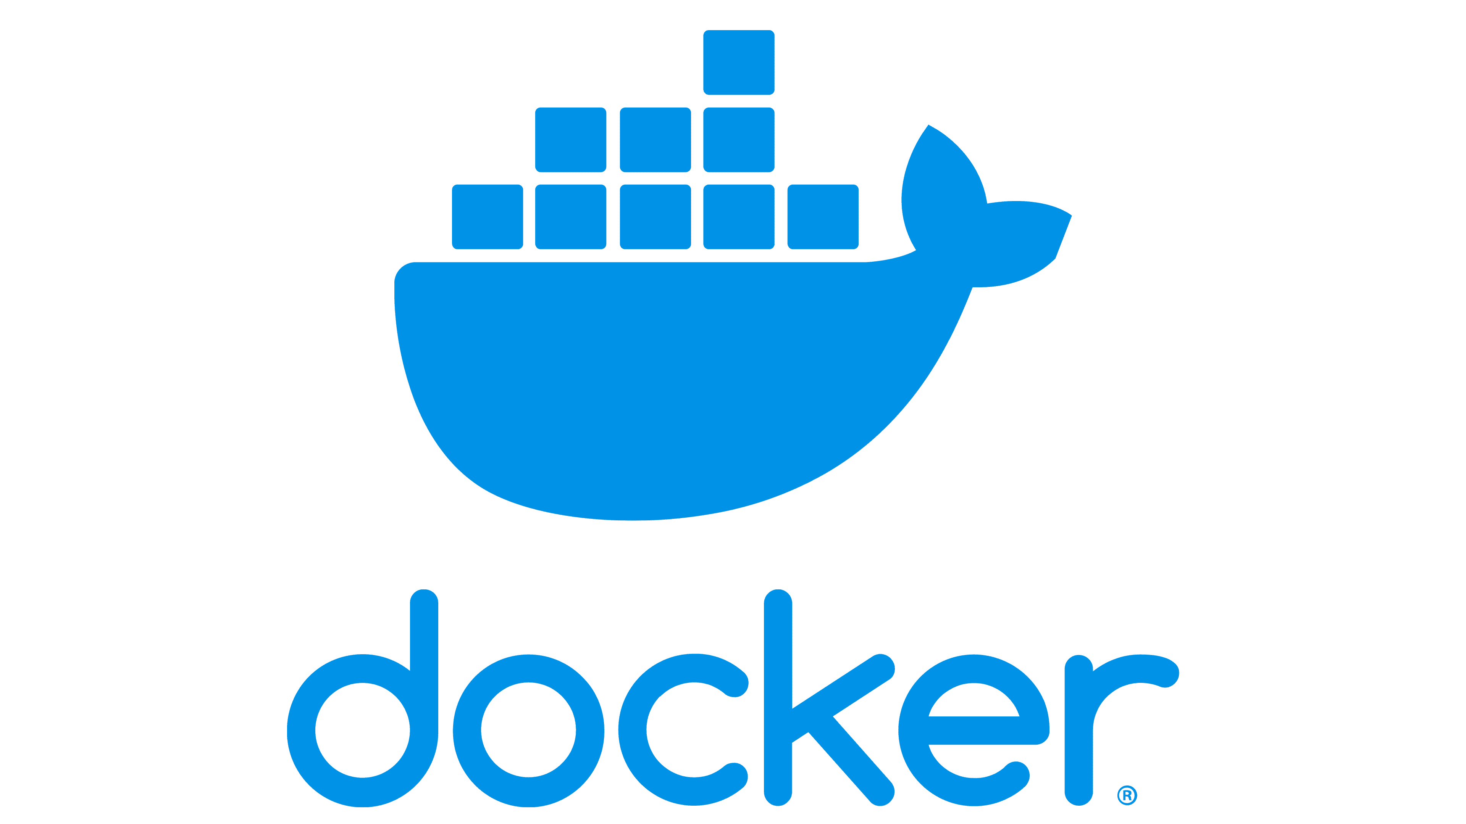
Docker Desktop
Recommended on Mac and Windows
Free for personal use and educational purposes
Requires a subscription if you use it for business
Notes:
https://hub.docker.com/signup?redirectTo=/subscription?plan=free
https://www.docker.com/pricing/

Slide 11

Alternatives to Docker
Podman is a drop-in replacement for Docker Engine
Podman is not a complete replacement for Docker Desktop
Notes:
https://podman.io/getting-started/installation

Slide 12
Glossary
Image
Container
Built from a Dockerfile
Once built, images are immutable
Can be shared via a Registry
A runtime instance of an Image
Many instances can share an Image
Containers have state

Slide 13
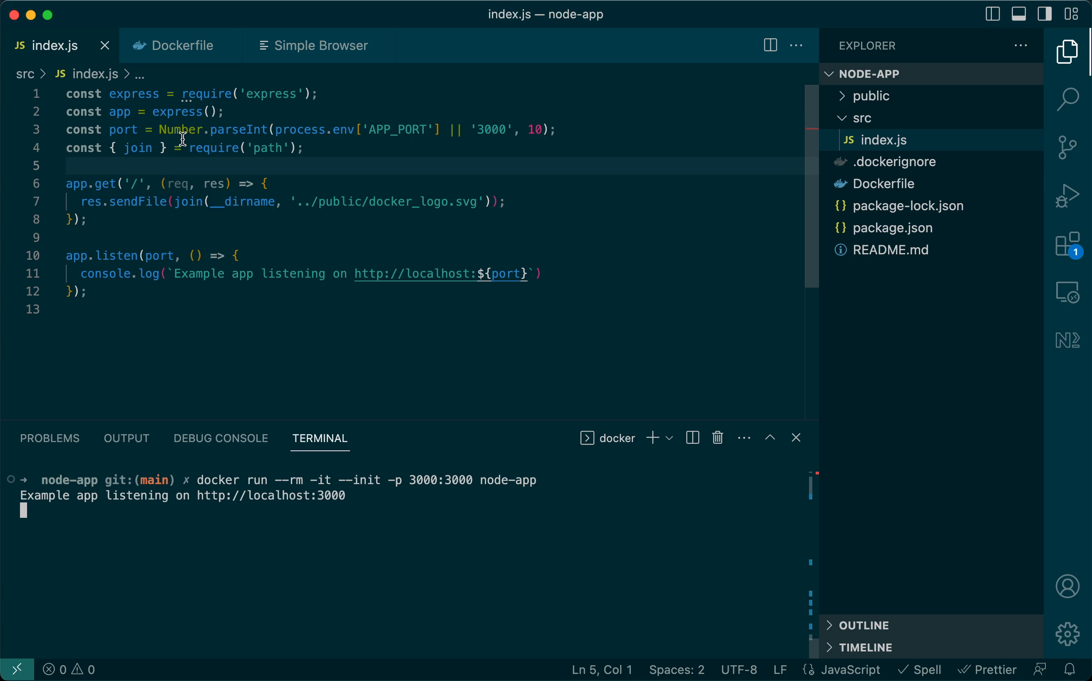
Let’s make a Container

Slide 14
Anatomy of a Dockerfile
Use official Node.js 18 image as base FROM node:18-slim
Copy the application source in /app RUN mkdir /app COPY . /app
Install dependencies RUN npm ci && npm cache clean -f
Configure and run app ENV APP_PORT=3000 CMD ["node", "./src/index.js"]
Notes:
https://docs.docker.com/engine/reference/builder/
https://docs.docker.com/develop/develop-images/dockerfile_best-practices

Slide 15
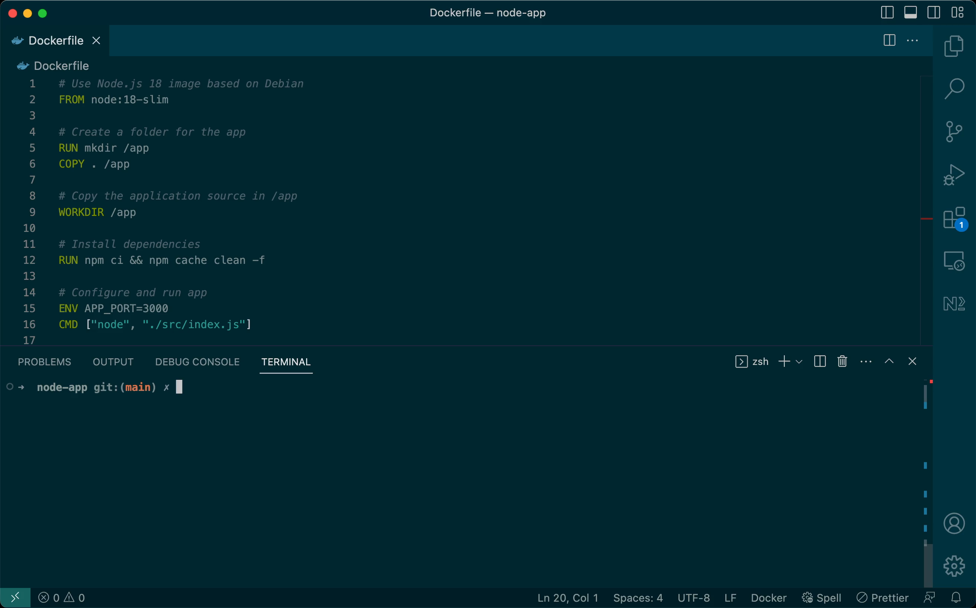
Building the Image
Notes:
https://docs.docker.com/engine/reference/commandline/build/

Slide 16
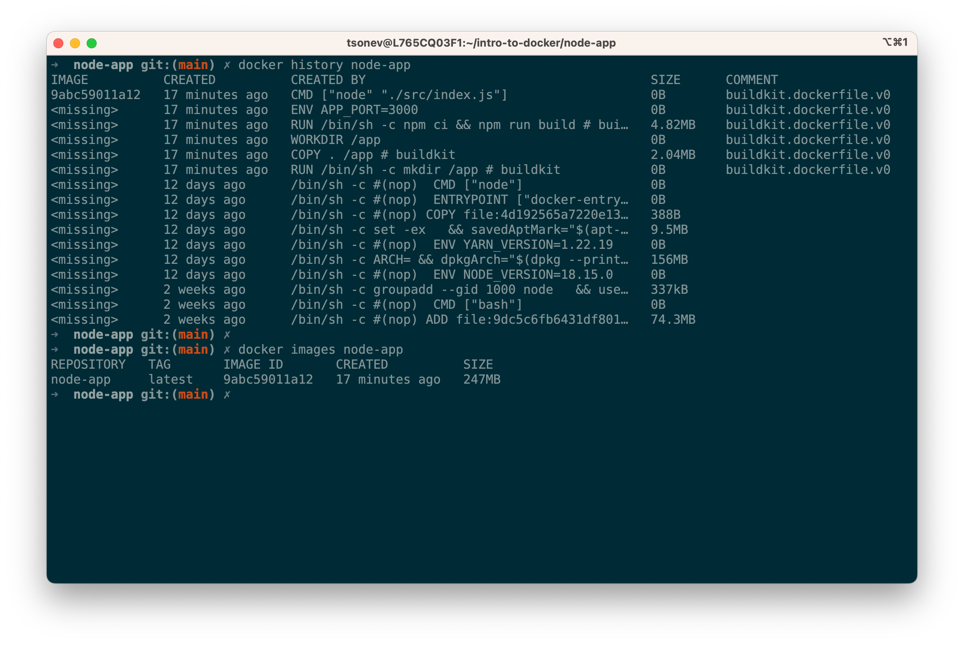
Image Layers
Each COMMAND creates a layer
A layer is a snapshot of the file system
Layers are cached and shared
Extra layers can increase image size
RUN npm ci && \
npm cache clean -f
To see all image layers, run:
docker history node-app

Slide 17
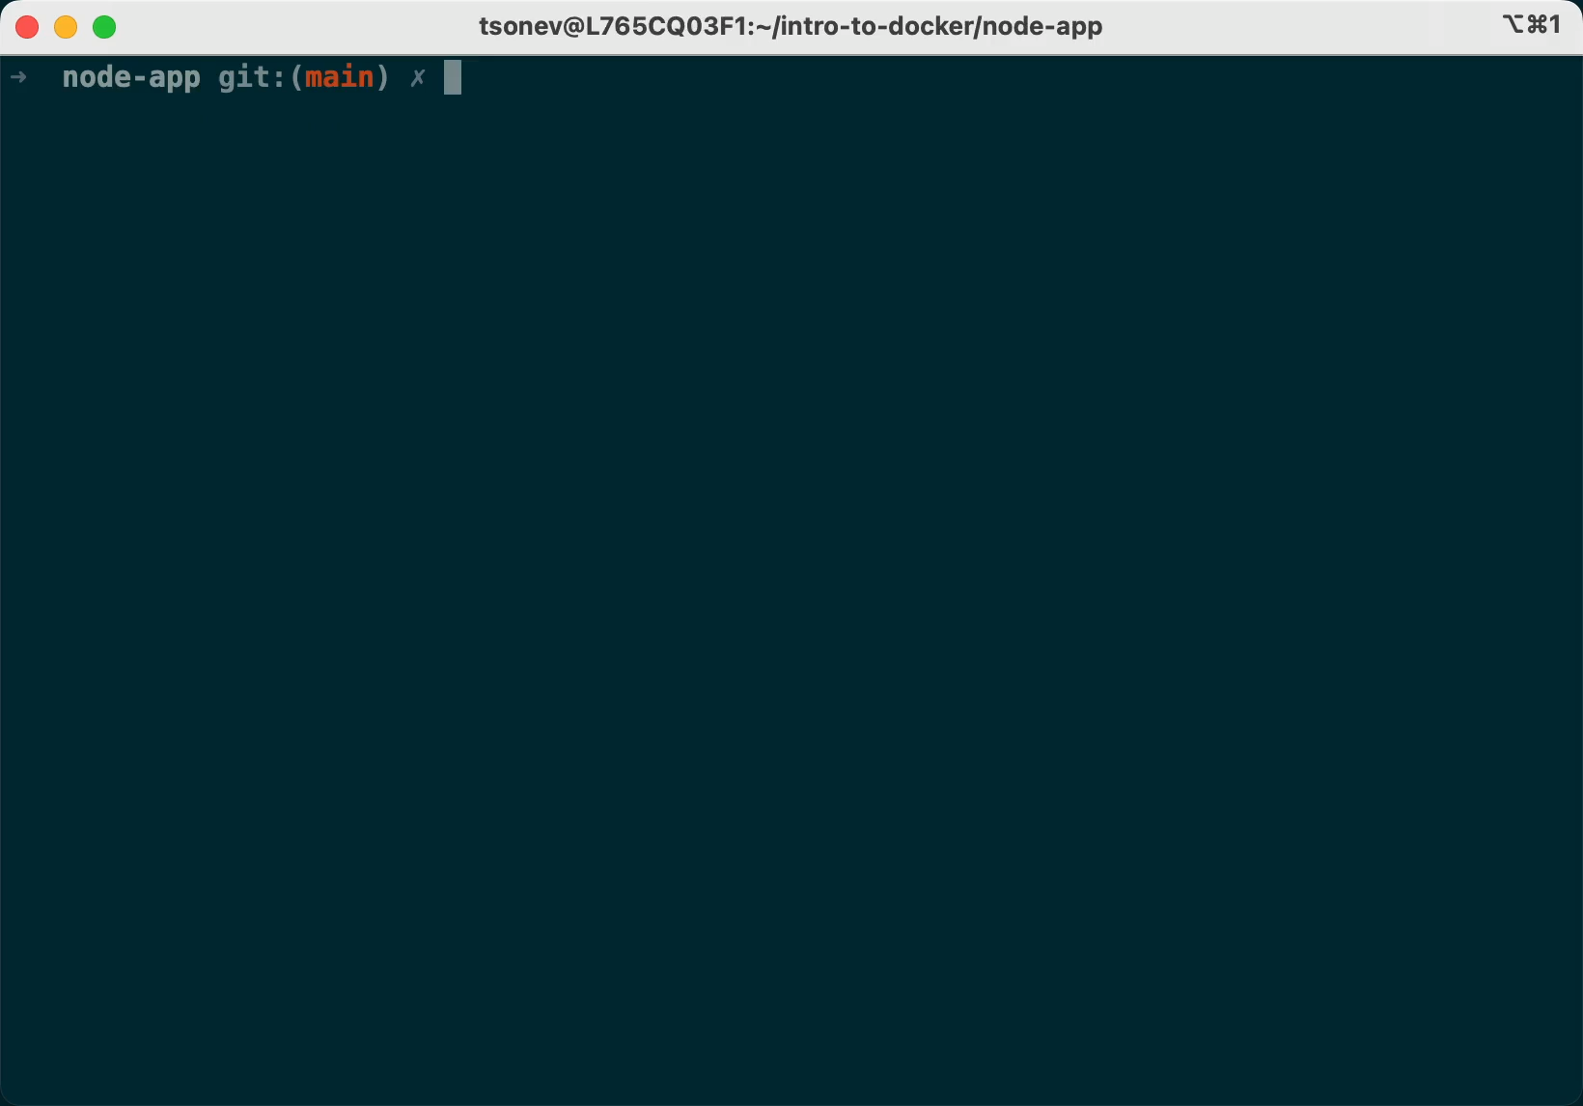
Container Lifecycle
Create a container instance docker create / docker run
Start / Stop a container
docker start / docker stop
Pause / Unpause a container
docker pause / docker unpause
Delete a container
docker rm
List containers
docker ps

Slide 18
Running the Container
Create and run docker run -d --init -p 3000:3000 --name node-app-1 node-app
Create, run and remove on exit docker run --rm --init -it -p 3000:3000 node-app
Notes:
https://docs.docker.com/engine/reference/commandline/run/

Slide 19
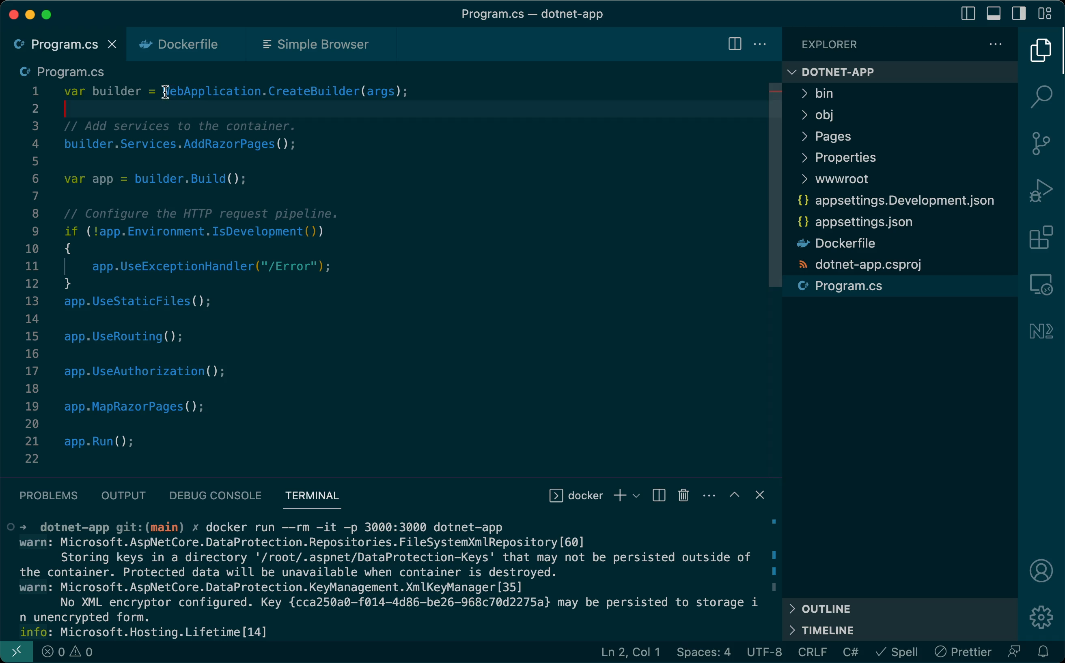
Let’s make a .NET Core Container
Notes:
https://github.com/dotnet/dotnet-docker/blob/main/samples/dotnetapp/README.md

Slide 20
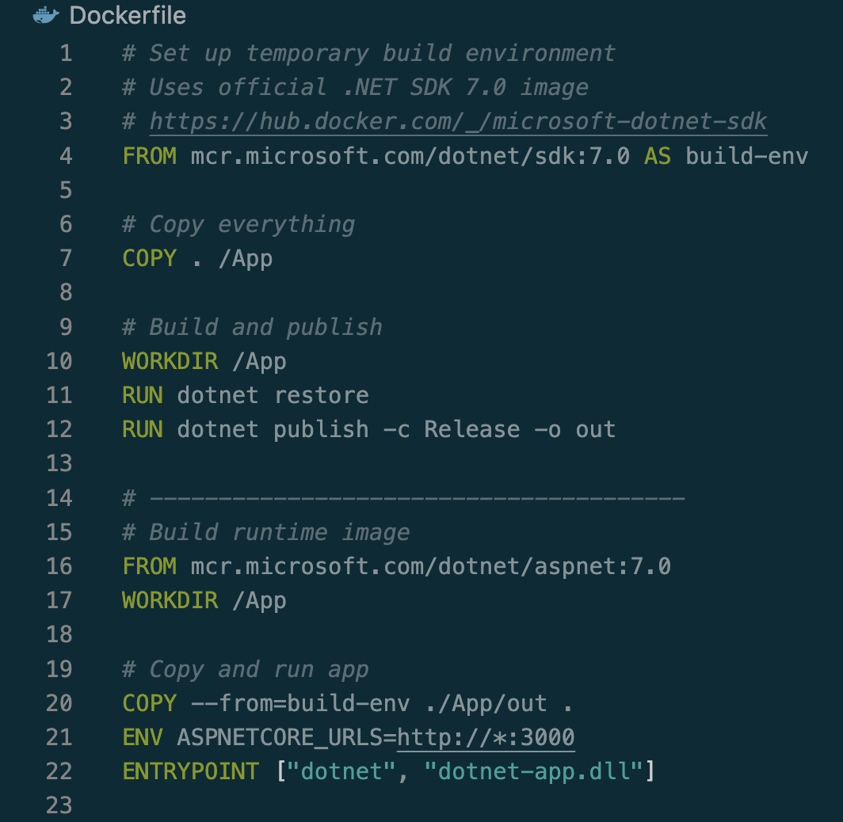
Anatomy of a multi-stage build
Use .NET SDK as build image
Use ASP.NET as run-time image

Slide 21
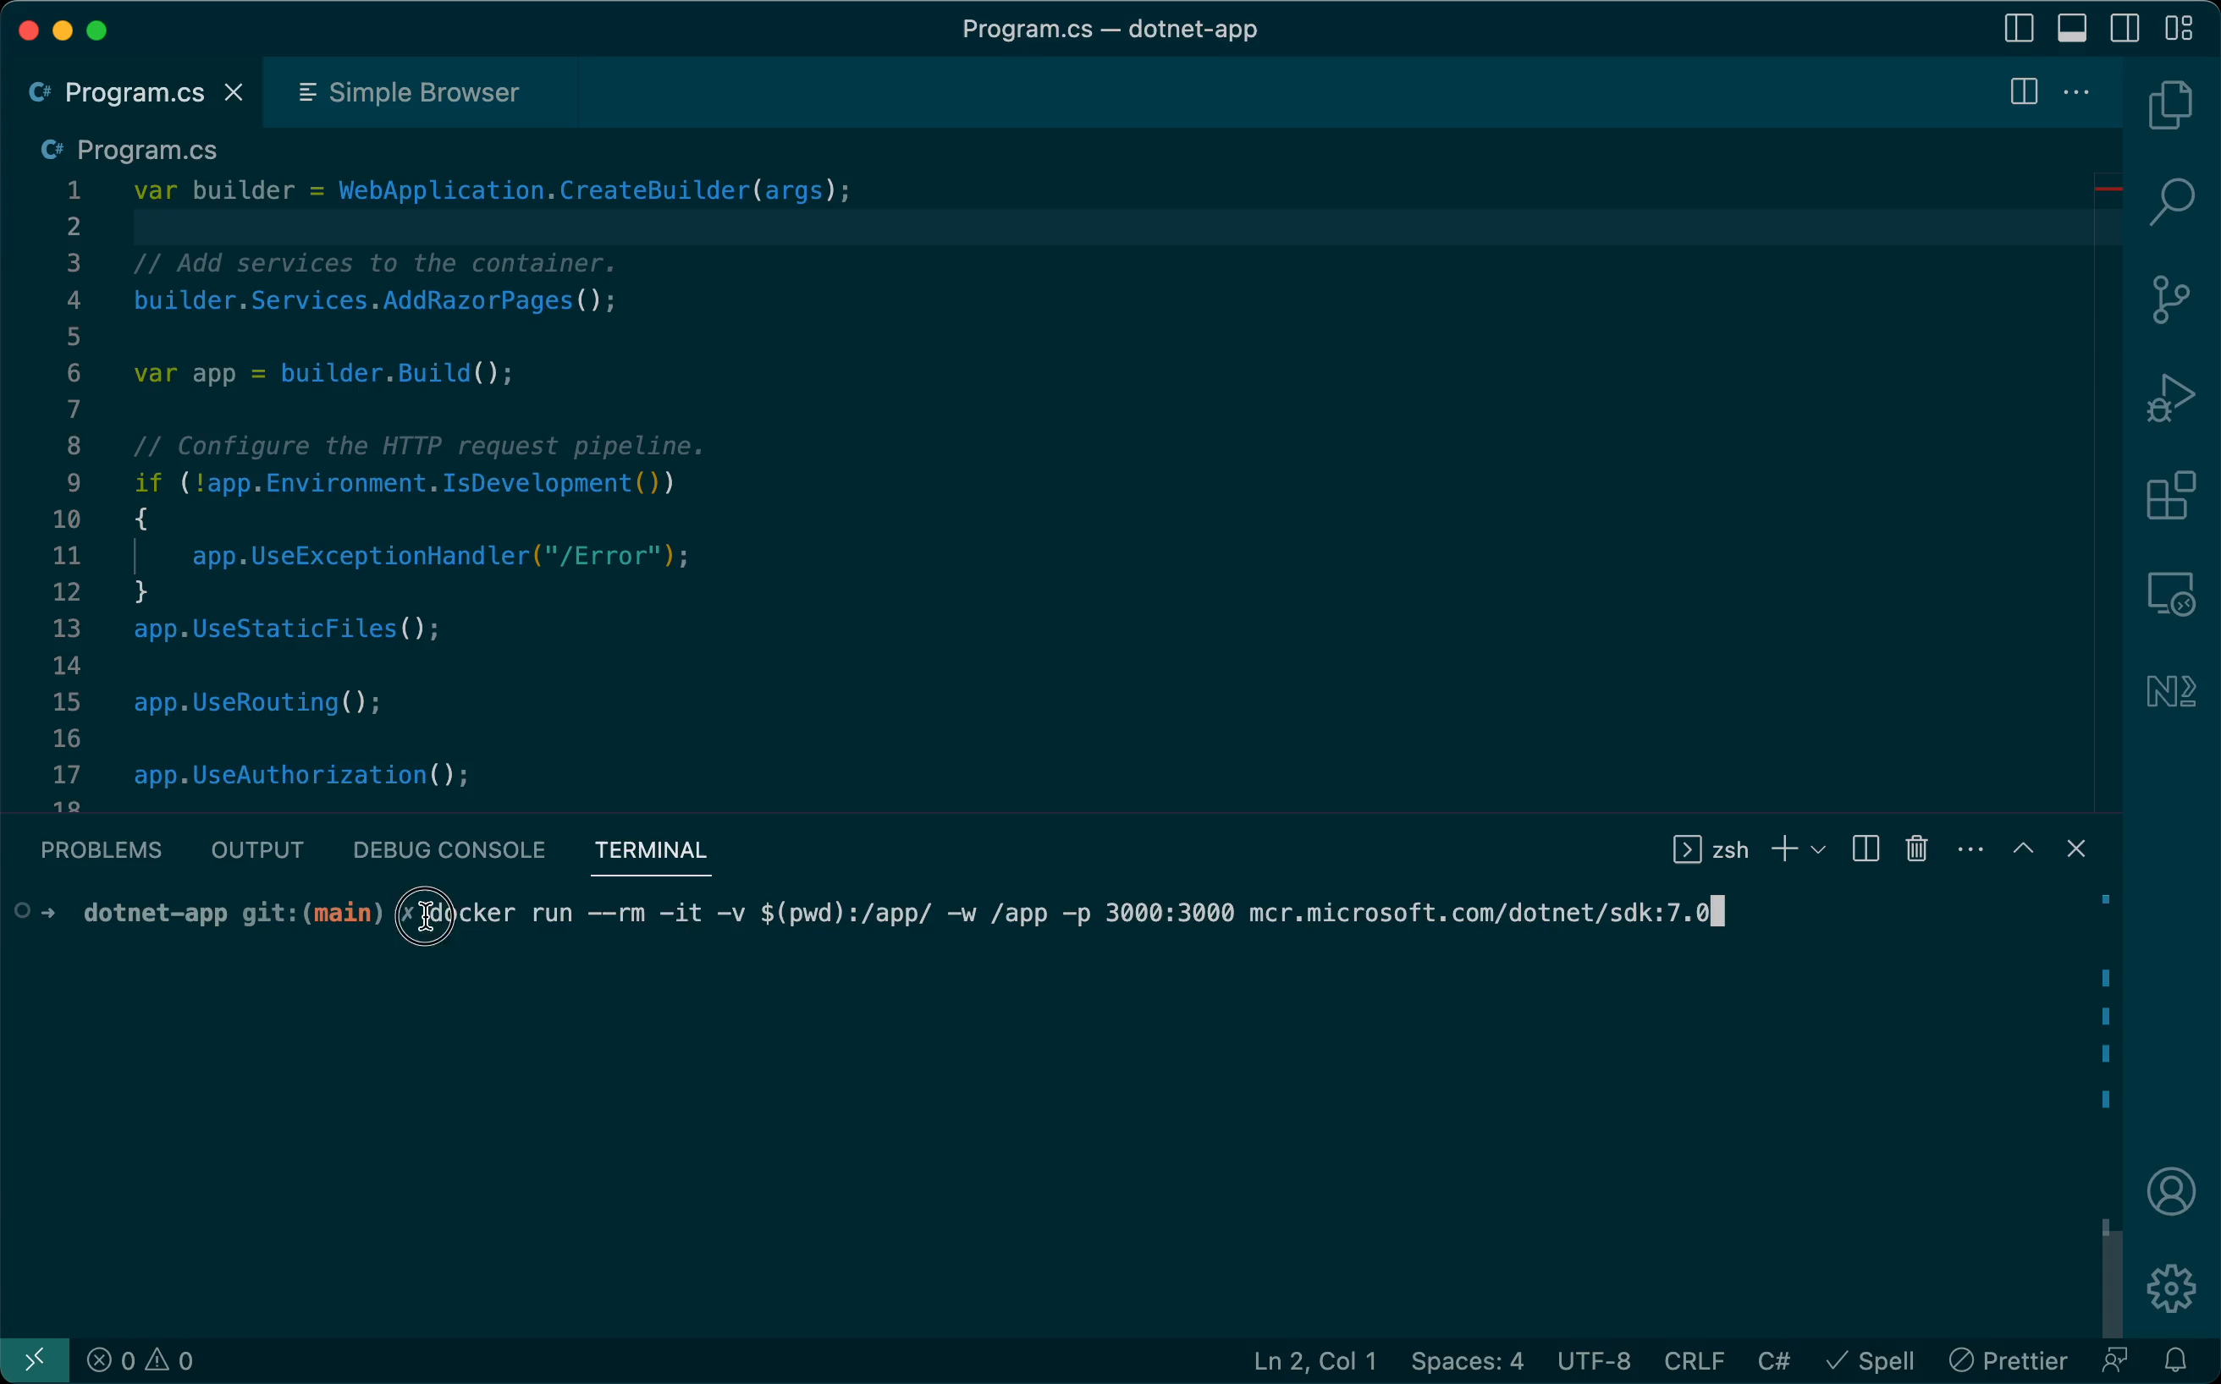
Look, no Dockerfile!
Notes:
https://github.com/dotnet/dotnet-docker/blob/main/samples/run-in-sdk-container.md

Slide 22
Tips and Tricks for Images
Prefer official images for common software stacks
Otherwise, use Debian Linux as base
Don't worry too much about image size
Notes:
https://github.com/tsvetomir/presentations/tree/main/intro-to-docker/node-app-debian

Slide 23
Poll: Next Topics
Containers in GitHub Actions
Deploying Container Apps
VS Code Development Containers
Windows Containers

